Slide 1
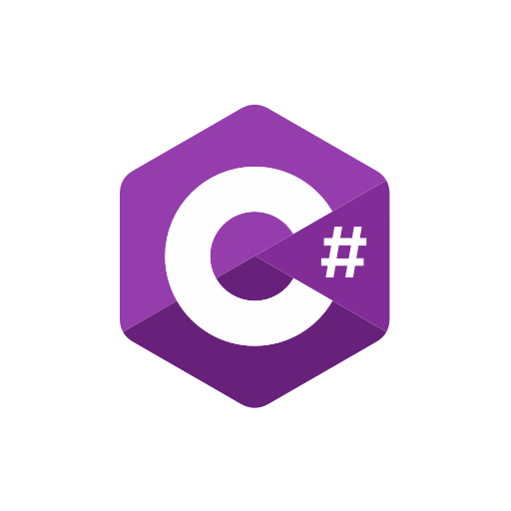
Visual C# .Net
Mrihan Mohamed Ahmed
Teaching Assistant - ITI
Mrihan.m.ahmed@gmail.com
01094984105

Slide 2
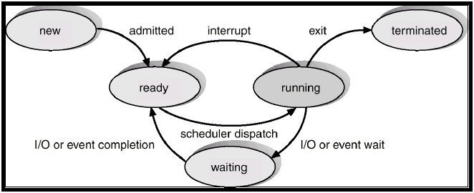
Process
A process is the instance of a computer program that is being executed. It contains the program code and its activity.
Notes:
Depending on the operating system, a process may be made up of multiple threads of execution that execute instructions concurrently.

Slide 3
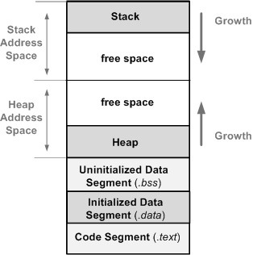
What is computer program?
A computer program is a collection of instructions that performs a specific task when executed by a computer.
A collection of computer programs, libraries, and related data are referred to as software.
Notes:
Code Segment: This segment stores the executable program code, variables defined with the const type
Initialized Data Segment: This segment stores all global variables and local static variables that have defined initial values different than zero. The segment’s size is determined by the size of the variables and is know at compile time.
Uninitialized Data Segment: This segment stores all global and local variables that are initialized to zero or do not have explicit initialization in the source code.
Heap: The heap is a segment of the system memory (RAM) that provides dynamic memory allocation.
Stack: LIFO, where automatic variables are stored, along with information that is saved each time a function is called. Each time a function is called, the address of where to return to and certain information about the caller’s environment, such as some of the machine registers, are saved on the stack.

Slide 4
Programming Language Levels
Height
Machine
Assembly
Low
Notes:
Machine Code: The very lowest possible level at which you can program a computer is in its own native machine code, consisting of strings of 1's and 0's and stored as binary numbers.
Assembly Language: is nothing more than a symbolic representation of machine code, which also allows symbolic designation of memory locations.
Compiler Language: is the high-level equivalent of assembly language. Each instruction in the compiler language can correspond to many machine instructions.
Interpreter Language: is considered to be high level. However, it operates in a totally different manner from a compiler language. Rather, the interpreter program resides in memory, and directly executes the high-level program without preliminary translation to machine code.

Slide 5
What is C#?
C# is a simple & powerful object-oriented programming language developed by Microsoft.
C# can be used to create various types of applications, such as web, windows, console applications or other types of applications using Visual studio.
C# has evolved much since its first release in 2002. C# was introduced with .NET Framework 1.0 and the current version of C# is 8.0.
Notes:
https://www.tutorialsteacher.com/csharp/csharp-version-history

Slide 6
What is .Net?
The .NET Framework is a platform where you can write different types of web and desktop based applications.
You can use C#, Visual Basic, F# and Jscript to write these applications.
If you have the Windows operating system, the .NET framework might already be installed in your PC.
Notes:
A computing platform or digital platform is the environment in which a piece of software is executed. It may be the hardware or the operating system, even a web browser and associated application programming interfaces, or other underlying software, as long as the program code is executed with it.

Slide 7
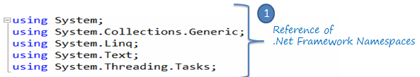
Dynamic Link Library
Is a file without entry point that can be included as a library in other programs.

Slide 8
Common Language Runtime
It’s responsible of the program execution and application management.
Contains the following parts:
Class loader
Debug manager
Exception manager
Type checker
Thread support
Just in time compiler
Garbage collector
Code manager
Security engineer

Slide 9
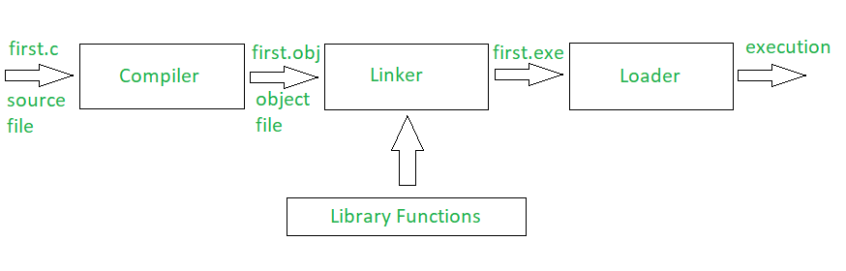
How program works?

Slide 10

Let’s get started

